Slide 1
P
O
R
J
E
T
O
N
E
TEAM MEMBER:毛一鸣、窦晓磊、储含露、朱正一
Speaker:毛一鸣
2019.6.1

Slide 2
Abstract
Our team’s work of project one is about Hybrid Renewable Energy Systems.
Our aim is to produce power with less costs by adjusting the energy ratio and at the same time reduce the pollution of the environment.
In this project, we present NSGAII and SMPSO for the optimization of the power generated from a Hybrid Renewable Energy Systems (HRES).

Slide 3
CONTENTS
Introduction
Proposed Algorithm
NSGA-II and SMPSO
Experiment and Result
Conclusion

Slide 4
Introduction
/01

Slide 5
Introduction
Renewable power generation can help countries meet their sustainable development goals through provision of access to clean, secure, reliable and affordable energy.
The Hybrid Renewable Energy Systems (HRES) are a combination between more than one renewable energy source or at least one renewable source to conventional source and it can be either grid connected or better to be in stand-alone mode due to its advances in renewable energy technologies and power electronics converters which are used to convert the unregulated power generated from renewable sources into useful power at the load end.

Slide 6
Introduction
The most important advantage of HRES is to make best use of the renewable power generation technologies operating characteristics and to obtain efficiencies higher than that could be obtained from if a single power source is used. It can also address limitations in terms of fuel flexibility, efficiency, reliability, emissions and economics.
However, renewable power generation maybe cannot satisfy the need in producing electricity. We need to use non-renewable resources to get more low-price energy. This action will create new some new problems in environment. Therefore, we should take this into consideration to use non-renewable resources rationally.

Slide 7
Proposed Algorithm
/02

Slide 8
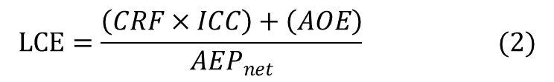
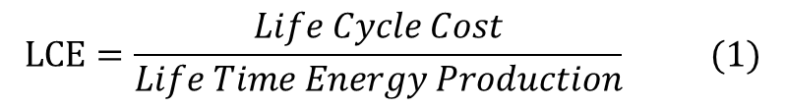
Proposed Algorithm--LCE evaluation
The most important objective of any renewable energy production project in the current deregulating environment is maximizing the quality of services by reducing the costs for customers, the investments, operation and maintenance.
we use algorithm to minimize the Levelized Cost of Energy (LCE).LCE can be explained as the price that energy has to be sold to break even over the lifetime of the technology.
$$LCE=\frac{Life Cycle Cost}{Life Time Energy Production} (1)$$
Where:
LCE: Levelized Cost of Energy (€/kW)
CRF: Capital Recovery Factor (%)
ICC: Installed Capital Cost (€/kW)
AOE: Annual Operating Expenses (€/kW)
AEPnet : Net Annual Energy Production (kW)
$$LCE=\frac{\left(CRF×ICC\right)+\left(AOE\right)}{{AEP}_{net}} (2)$$

Slide 9

Proposed Algorithm--LCE evaluation
For more details:
$$CRF=\frac{{d\left(1+d\right)}^{n}}{{\left(1+d\right)}^{n}−1} (3)$$
$$AOE=ANN+\left(O\&M×n\right) (4)$$
Where
CRF: Capital Recovery Factor (%)
ICC: Installed Capital Cost (€/kW)
d: interest rate (%)
n: operational life (years)
ANN: the annualized costs (insurance, other expenses)
O&M: Operation & Maintenance Cost (€/kW)

Slide 10
Proposed Algorithm--PTE evaluation
As we have motioned before, renewable energy always cost a lot of money and often fails to meet the demand. We also need to make rational use of some non-renewable energy sources. In our project, we use two kinds of energy, Diesel generator and Lead-acid battery.
We propose PTE(Equations 5) to assess the environmental pollution caused by these two kinds of energy sources.
$$PTE={P_{Lead−acid battery}}^{2}+P_{Diesel generator} (5)$$

Slide 11
Proposed Algorithm--Power Generated Constrain
The project should be composed with constraints to obtain the proper objective function.
The main constraints in the optimization process in the proposed methodology are the total power.
In reality, the annual energy requirement is limited, so the sum of several kinds of energy should be limited to a certain extent.
$$1.1×AEPnet{≥P}_{Photovoltaic}+P_{wind turbine}+P_{Diesel generator}+P_{Lead−acid battery}≥AEPnet$$

Slide 12
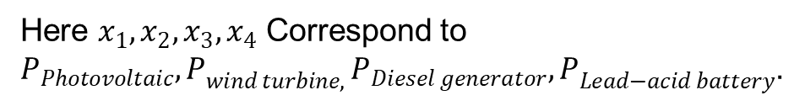
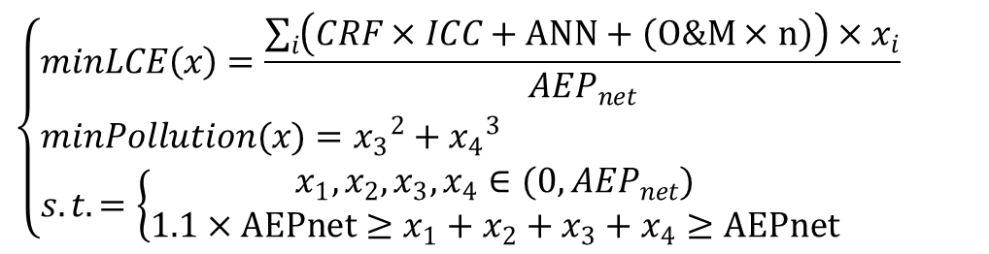
Proposed Algorithm--Multi-objective optimization equation
In summary, we propose the following equations to describe the whole power system.
$$\left\{\begin{aligned}&minLCE\left(x\right)=\frac{\sum_{i}{\left(CRF×ICC+ANN+\left(O\&M×n\right)\right)×x_{i}}}{{AEP}_{net}} \\ &minPollution(x)={x_{3}}^{2}+{x_{4}}^{3} \\ &s.t.=\left\{\begin{aligned}x_{1},x_{2},x_{3},x_{4}∈(0,{AEP}_{net}) \\ {1.1×AEPnet≥x}_{1}+x_{2}+x_{3}+x_{4}≥AEPnet\end{aligned}\right.\end{aligned}\right.$$
Here $x_{1},x_{2},x_{3},x_{4}$ Correspond to $P_{Photovoltaic}{,P}_{wind turbine,}P_{Diesel generator}{,P}_{Lead−acid battery}$.

Slide 13
NSGA-II and SMPSO
/03

Slide 14
NSGA-II
Non-dominated Sorting Genetic Algorithms with Elite Strategy (NSGA-II) is a very famous multi-objective optimization algorithm--a non-dominated sorting-based MOEA. Multi-objective evolutionary algorithms (MOEAs) that use non-dominated sorting and sharing (NSGA) have been criticized mainly for:
1、Their O(MN³) computational complexity (where M is the number of objectives and N is the population size);
2、Their non-elitism approach;
3、The need to specify a sharing parameter.
NSGA-II alleviates the above three difficulties.
Specifically, a fast non-dominated sorting approach with O(MN²) computational complexity is presented. Also, a selection operator is presented that creates a mating pool by combining the parent and offspring populations and selecting the best N solutions (with respect to fitness and spread). Simulation results on difficult test problems show that NSGA-II is able, for most problems.

Slide 15
SMPSO
Particle Swarm Optimization(PSO) algorithm，a population-based search algorithm，is a bio-inspired heuristic mimicking the social behavior of bird flocking or fish schooling. Its individuals, called particles and of which the population consist as swarm，move under a certain velocity vector through hyper dimensional search space. Changes to the position of the particles within the search space are based on the social-psychological tendency of individuals to emulate the success of other individuals. The position of each particle is changed according to its own experience and that of its neighbors to achieve ideal positions which form the optimal solutions.
Speed-constrained Multi-objective PSO(SMPSO) based on PSO, it employs velocity constriction method to produce new effective particle positions in those cases in which the velocity becomes too high. Other features of SMPSO include the use of polynomial mutation as a turbulence factor and crowded distance for uniformity in the fixed-size solution set.

Slide 16
Experiment and Result
/04

Slide 17
Experiment
All the experiment data comes from table. And we set Net Annual Energy Production(AEPnet) to 10,000kW.
Technology | Unit | Photovoltaic | Wind turbine | Diesel generator | Lead-acid battery
Investment cost | €/kW | 2,835.00 | 5832.00 | 596.00 | 148.00
Lifespan | Years | 20 | 20 | 20 | 5
Interest rate | % | 10 | 10 | 10 | 10
CRF | - | 0.1175 | 0.1175 | 0.1175 | 0.2638
Annualised | €/kW | 333.00 | 685.02 | 70.01 | 39.04
Investment cost Maintenance and operation cost | (€/kWh for battery) % of investment cost | 2 | 2 | 6.4 | 2
Maintenance and operation cost | €/kW (€/kWh for battery) | 56.70 | 116.64 | 38.08 | 2.96

Slide 18
Experiment
We use the JMetalPy framework.
In our NSGAII algorithm, we set population to 100, and the operators we used are Polynomial Mutation、SBX Crossover and Binary Tournament Selection.
In our SMPSO algorithm, as a contrast, we also set population to 100, and the operator we used is also Polynomial Mutation. And the Leader which we used to store the best solution, are selected by Crowding Distance Archive.

Slide 19
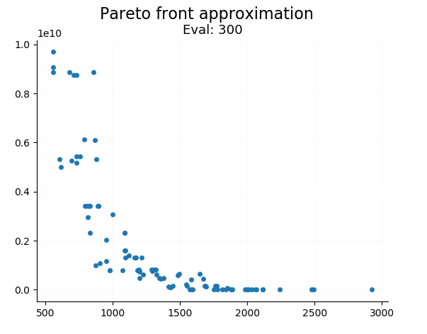
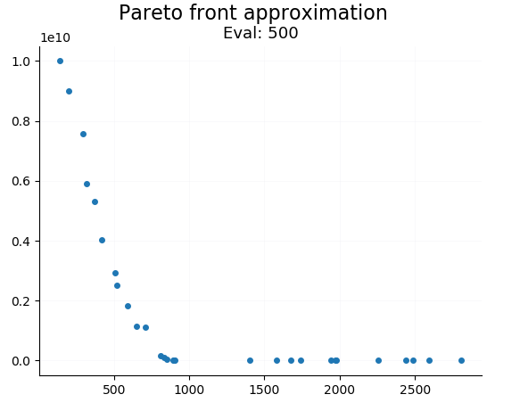
Result
As shown in the figure below, we give Pareto graphs of the two algorithms.
Pic.1 the pareto front at about 400 evaluations（left-nsgaii，right-smpso）

Slide 20
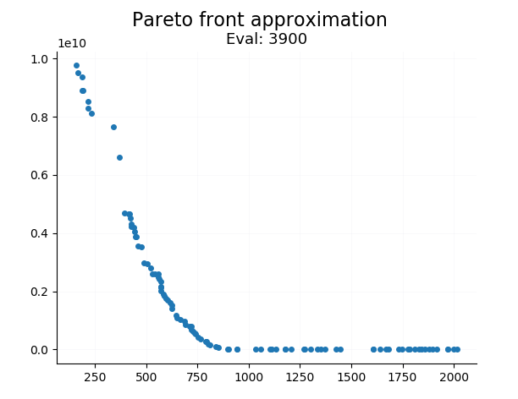
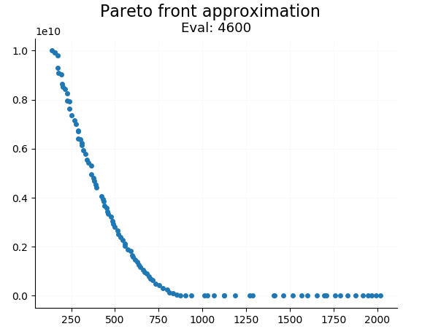
Result
Pic.2 the pareto front at about 4000 evaluations（left-nsgaii，right-smpso)

Slide 21
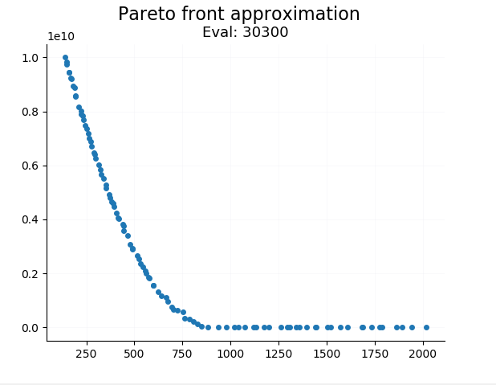
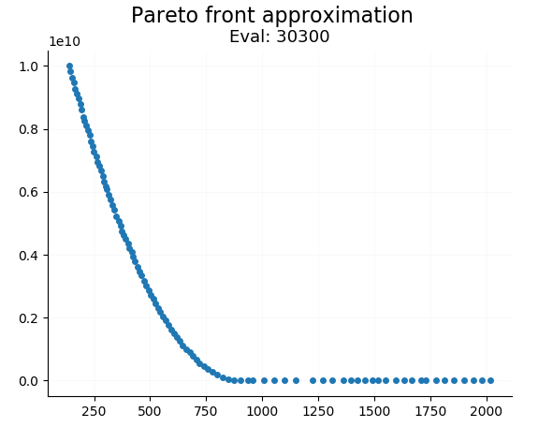
Result
Pic.3 the pareto front at about 30000 evaluations（left-nsgaii，right-smpso）

Slide 22
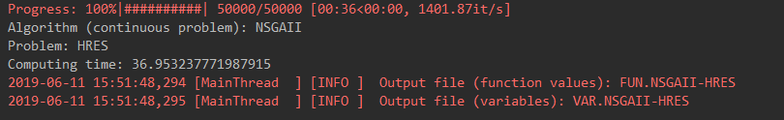
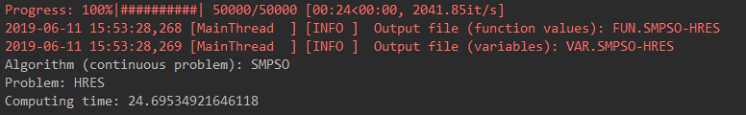
Result
Pic.4\5 The Computing time of two algorithm by 50000 times evalutions（above-nsgaii，below-smpso）

Slide 23
Conclusion
/05

Slide 24
Conclusion
This project discusses a simple general approach for the optimal power generated from multi sources in HRES to minimize the LCE and PTE using two algorithm: NSGAII and SMPSO.
Firstly, we obtained the LCE evaluation method widely used in the field of energy to evaluate the economic benefits of mixed energy by referring to relevant literature. Secondly, since HRES contains traditional energy, we add PTE to evaluate the environmental pollution degree of energy. Finally, considering the restriction factor of total energy power, we build a multi-objective optimization problem model about HRES.

Slide 25
Conclusion
The SMPSO and NSGA-II are efficient and effective heuristic algorithms in MOP problems. Two evaluation metrics of algorithm are used to compare convergence and diversity of evolutionary algorithms. SMPSO having more simple computational complexity will spend shorter time in every generation. SMPSO has better diversity with respect to Pareto fronts. Nevertheless，NSGA-II has better convergence compared with SMPSO in the same generation. By analyzing the standard deviation value, it is investigated that the quality of SMPSO solutions is much more stable than NSGA-II. It illustrates that different algorithms are suitable for a certain range of optimization problems.
Finally, we complete the multi-objective optimization problem of HRES and obtain Pareto diagrams related to LCE and PTE. It provides reference basis for the possible solution of HRES problem.

Slide 26
Thanks

